Slide 1
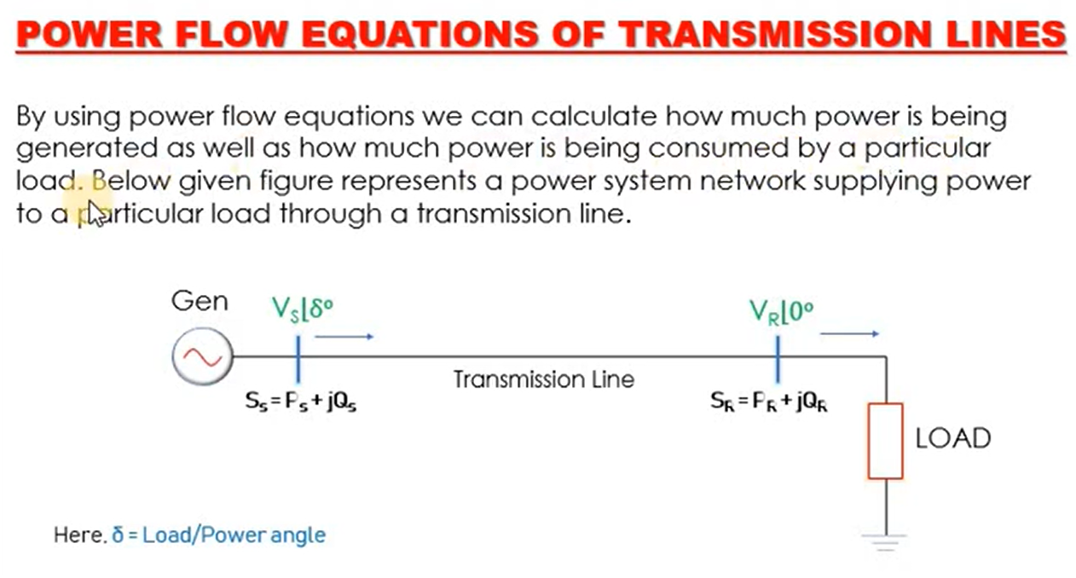

Slide 2
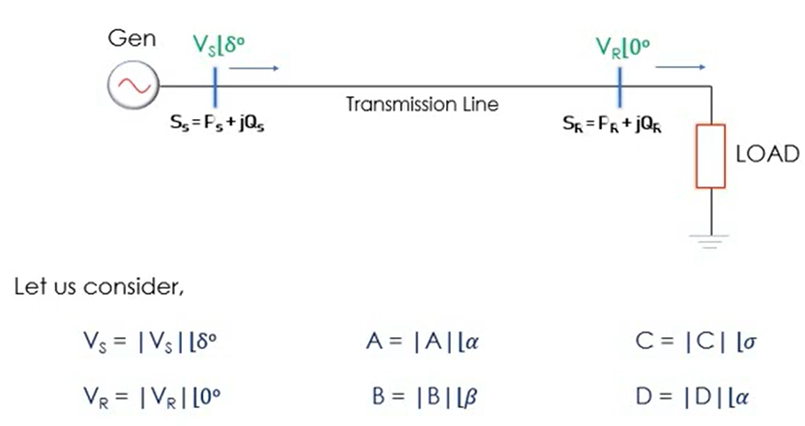

Slide 3
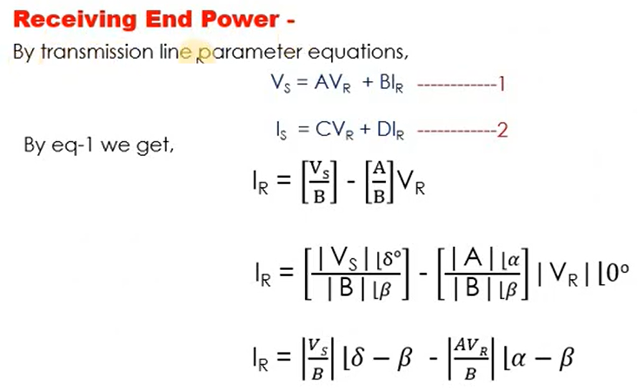
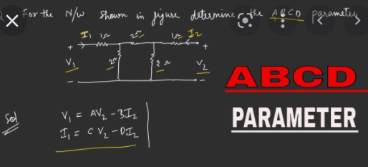

Slide 4
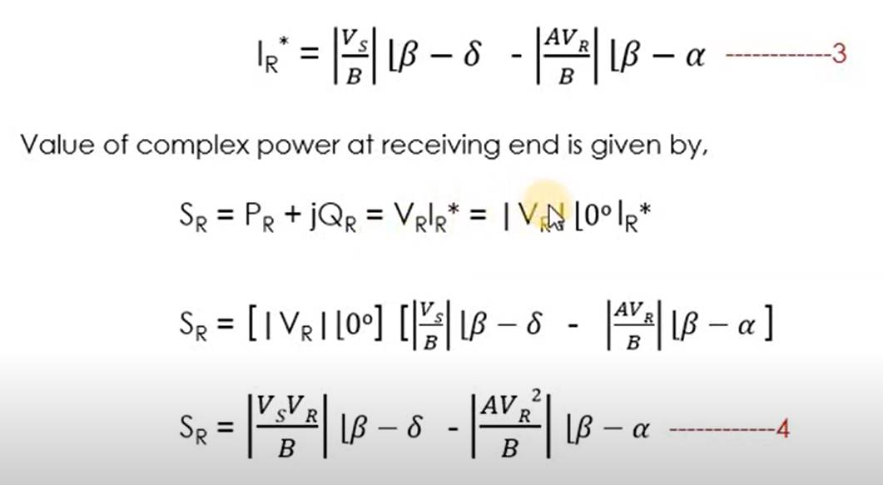

Slide 5
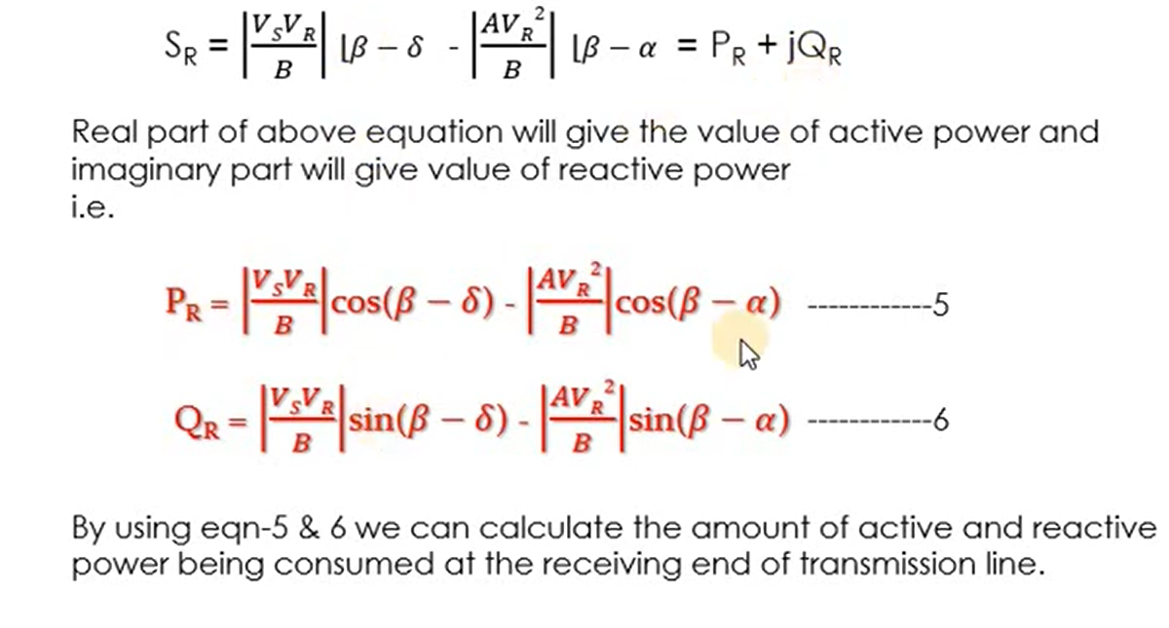

Slide 6
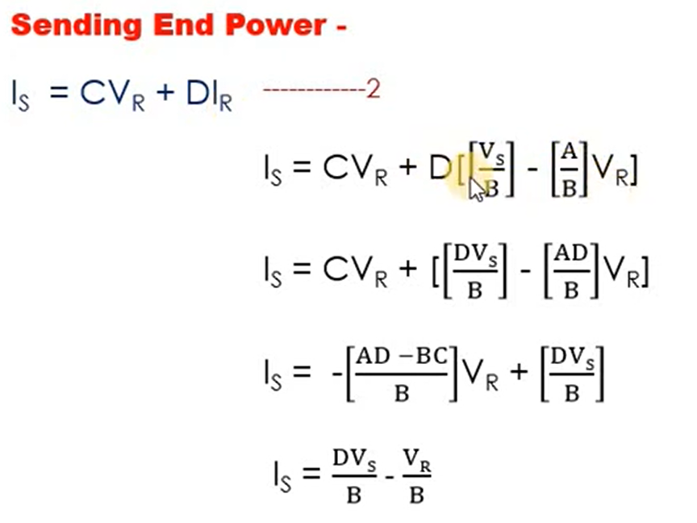

Slide 7
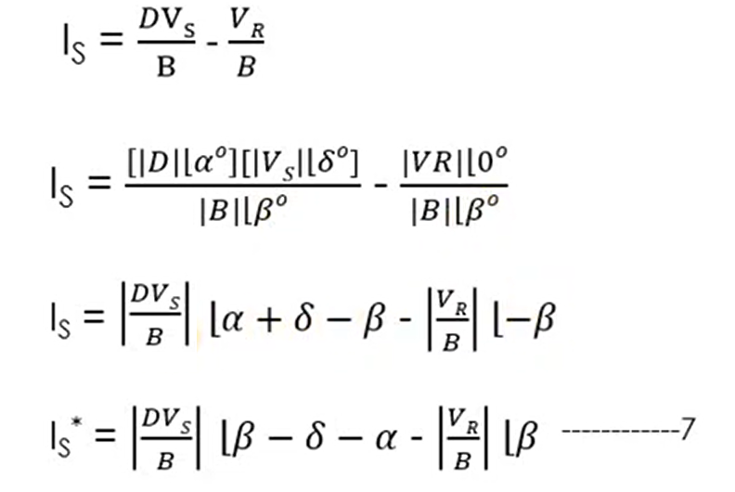

Slide 8
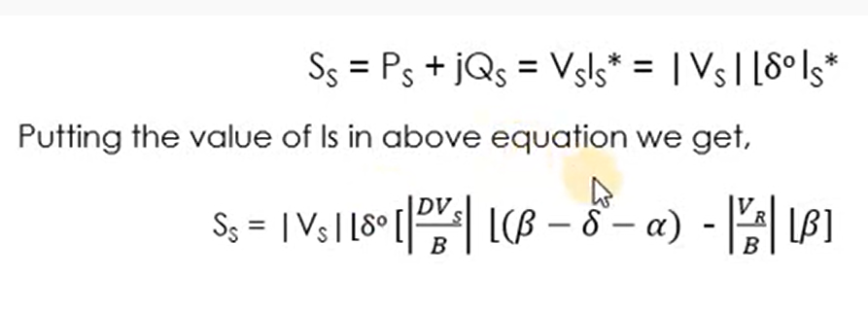

Slide 9
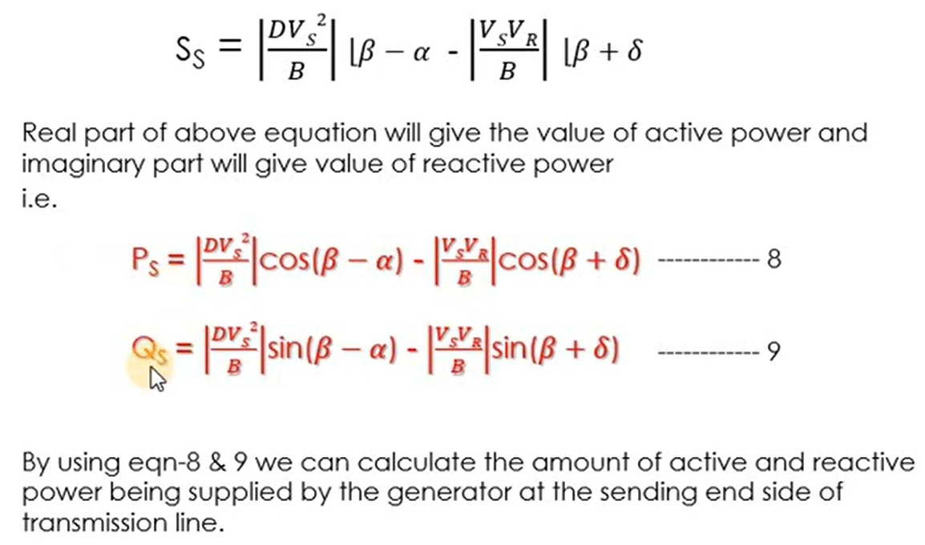

Slide 10
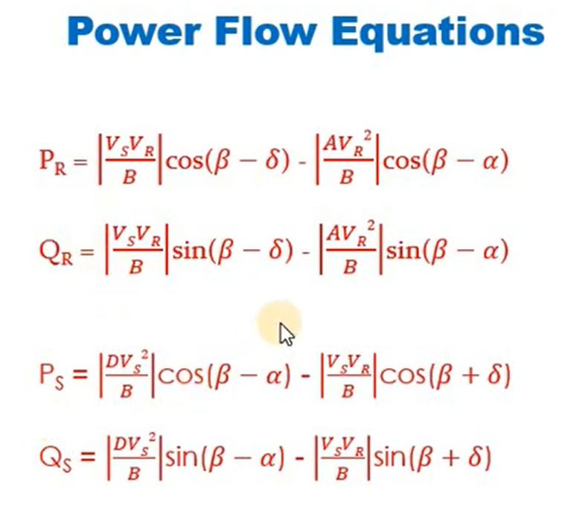

Slide 11
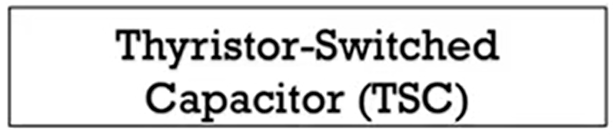

Slide 12
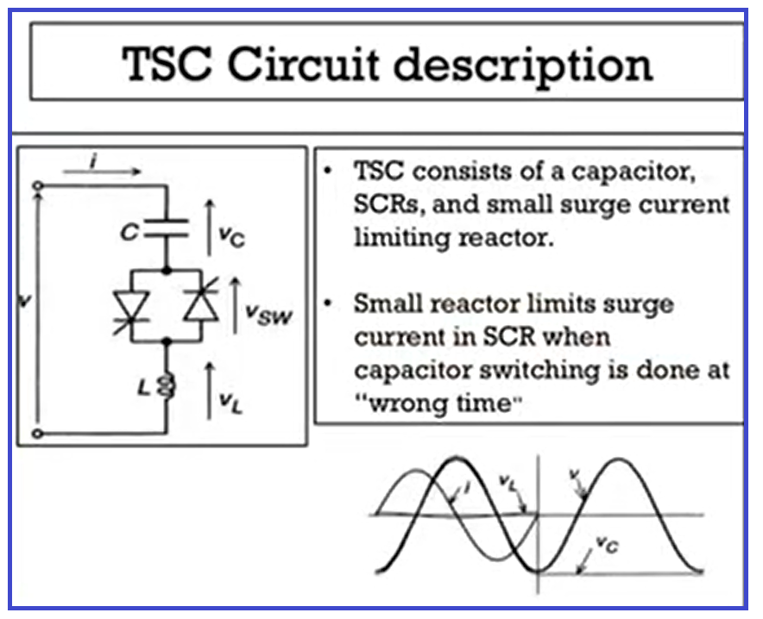
TSC consists of one capacitor.
Back to back SCR.
And there is small reactor also .
Reactor is used to limit the surge current which may be flow through SCR as well as capacitor.
It damaging the SCR particularly if capacitor switching is done at wrong time .
Wrong time means if the voltage across SCR is not equal to zero and the SCR is triggered than the current is transient or transients may be produced.
These transients may be harmful for SCR
Triggering means turning ON of a device from its off state

Slide 13
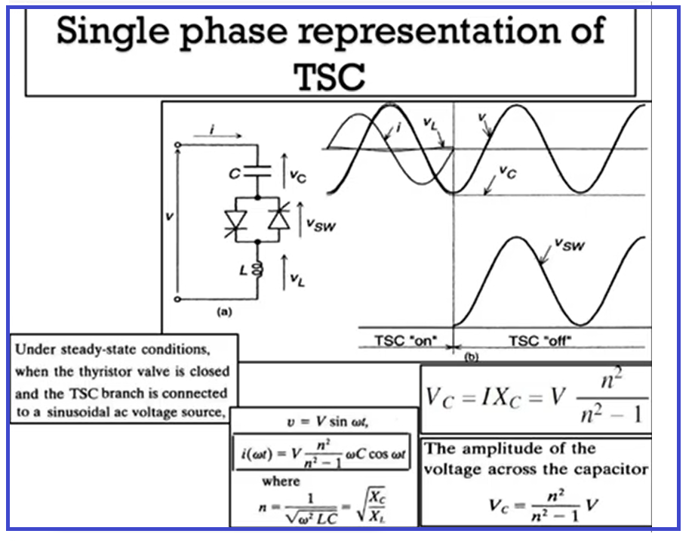

Slide 14
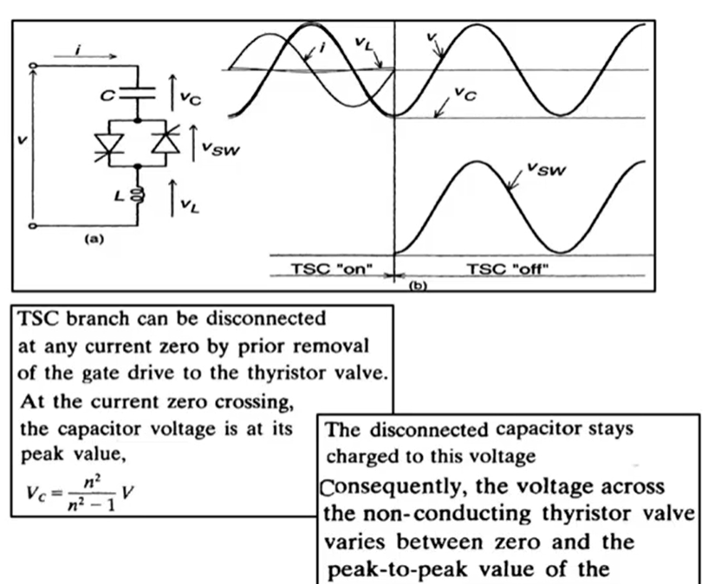

Slide 15
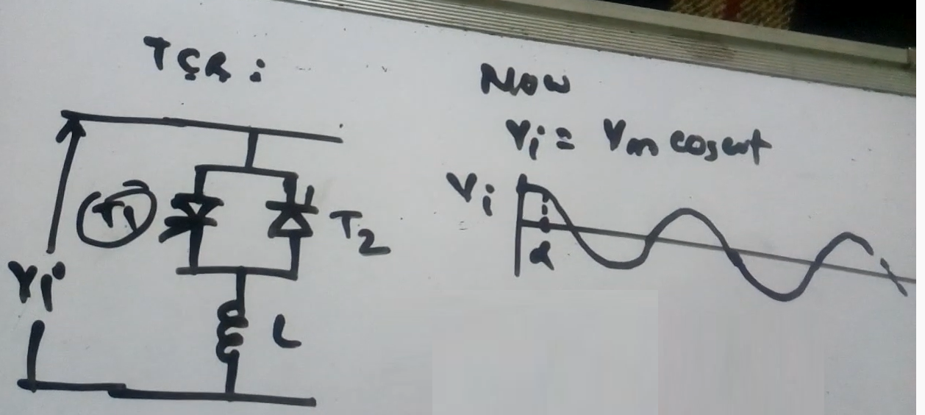

Slide 16
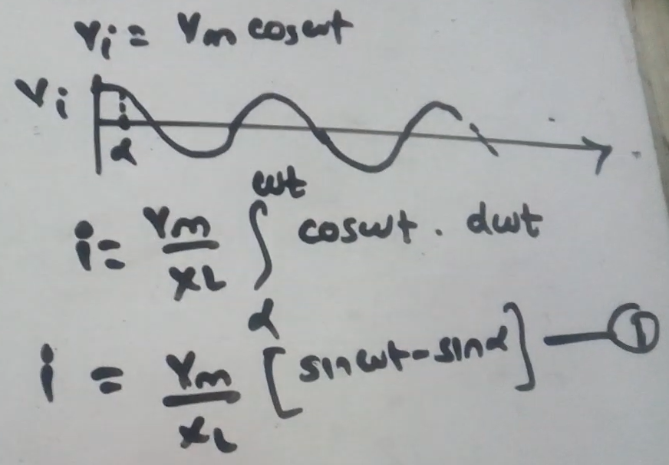

Slide 18
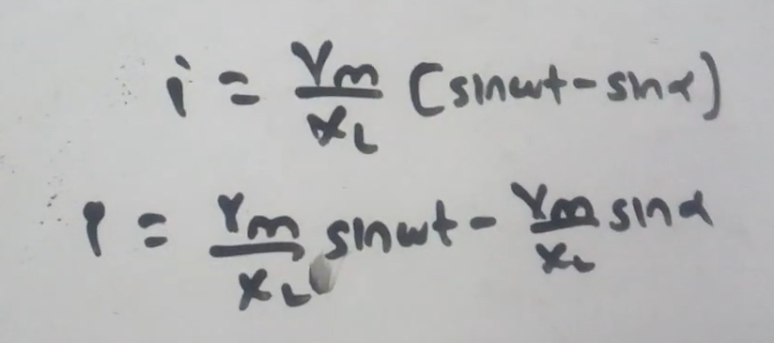

Slide 19
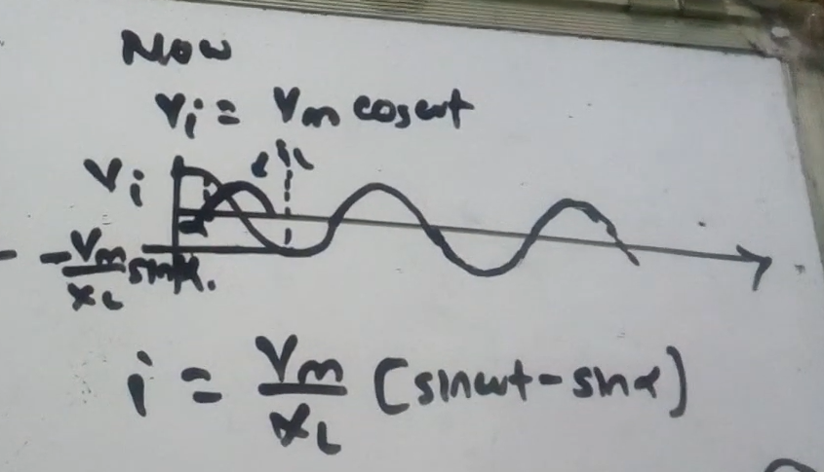

Slide 20
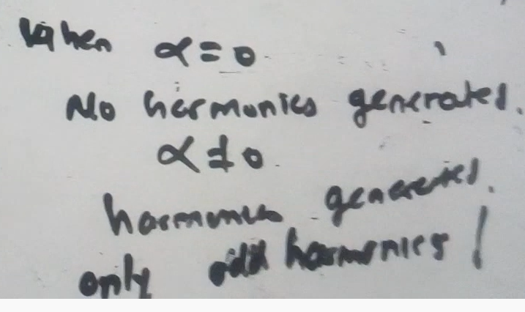
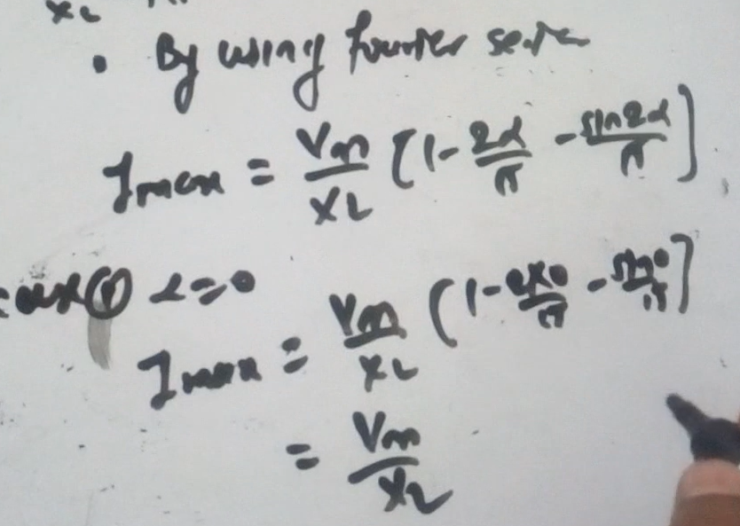

Slide 21
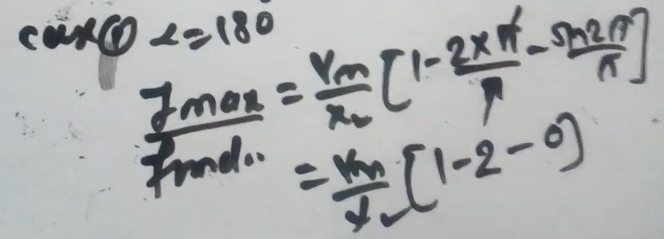
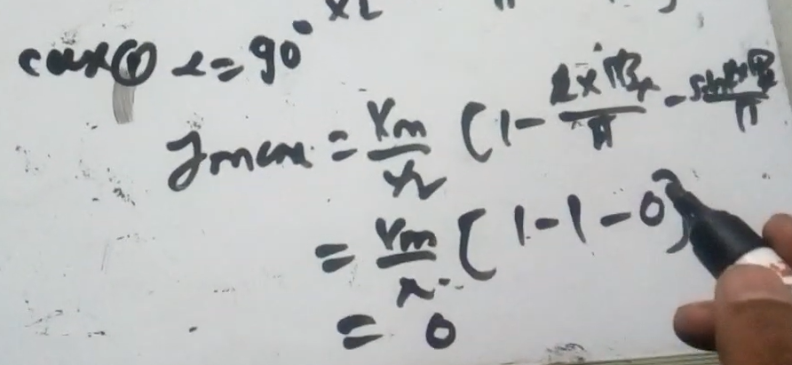

Slide 22
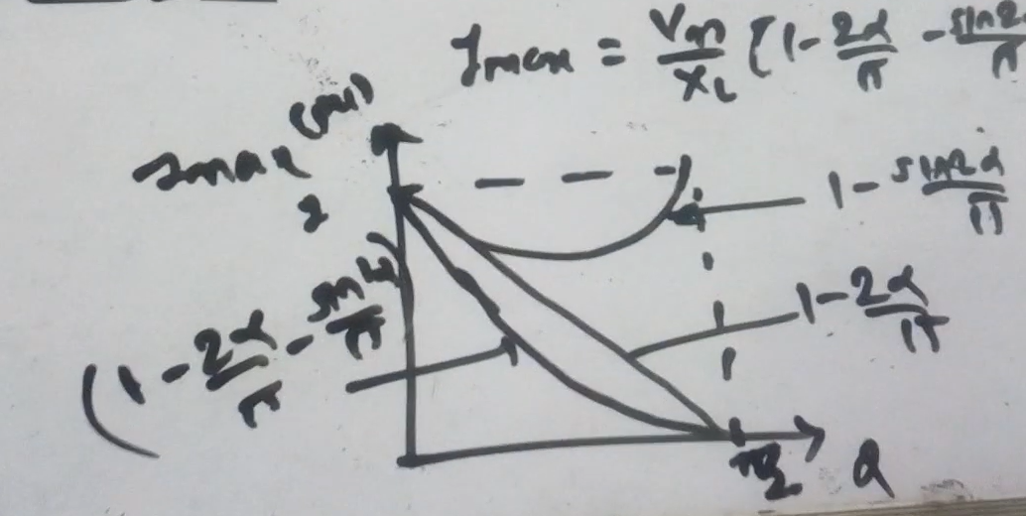

Slide 23
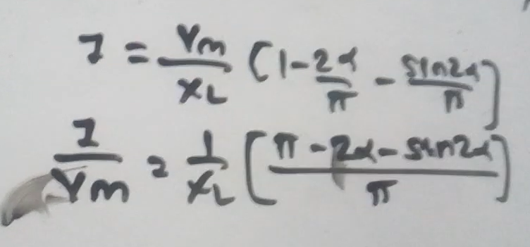

Slide 24
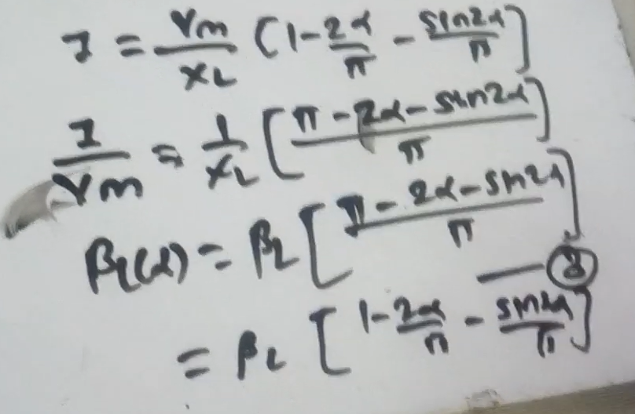
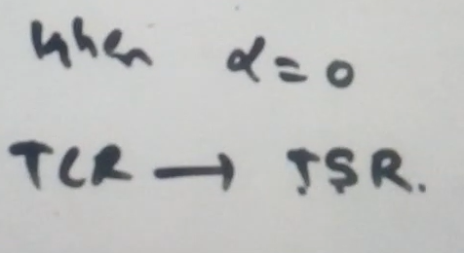

Slide 25
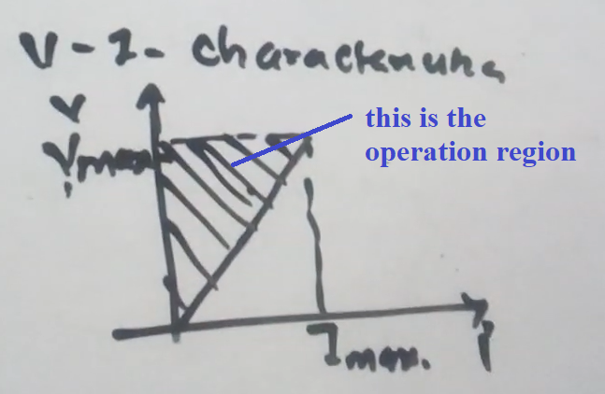

Slide 26
Thyristor Controlled Reactor
Thyristor controlled reactor consist reactor L placed in series with the thyristor valve.
This reactor is the controlled element of the TCR, and it controls the thyristor valve.
TCR consists two opposite poled thyristor which conducts every alternate half cycles of the supply.
In TCR the duration of current flowing through the reactor is controlled by the firing angle of the thyristor.
For every half cycle, the thyristor is given a triggering pulse by the controlled circuit.
It is used in EHV (Extra High Voltage) lines for providing lagging VARs during the low load or load rejection.

Slide 27
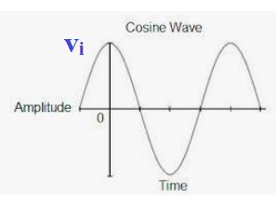
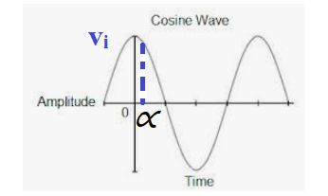
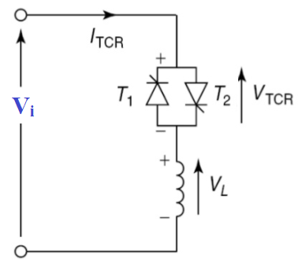
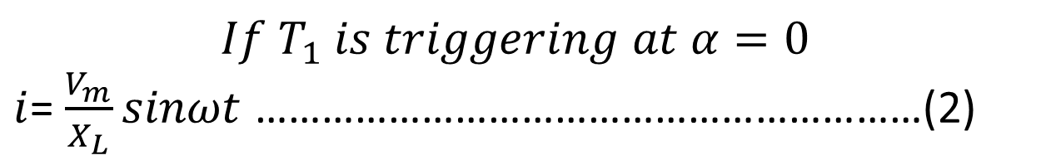
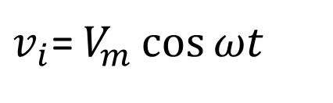
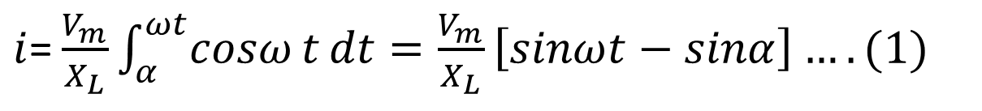
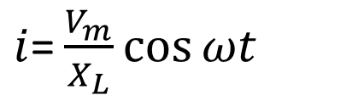
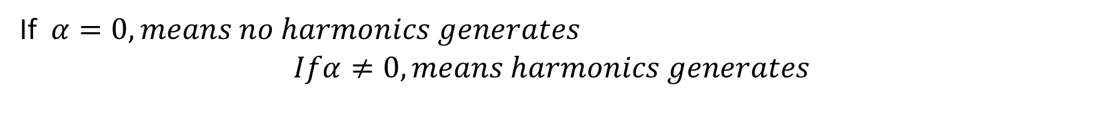
$v_{i}$= $V_{m}\cos{ωt}$
$i$= $\frac{V_{m}}{X_{L}}\cos{ωt}$
$i$= $\frac{V_{m}}{X_{L}}\int_{α}^{ωt}{cosω}t{dt=\frac{V_{m}}{X_{L}}\left[sinωt−sinα\right]….(1)}$
$$If T_{1} is triggering at α=0$$
$i$= $\frac{V_{m}}{X_{L}}sinωt$ ……………………………………………………(2)
If $α=0, means no harmonics generates$
$$Ifα≠0, means harmonics generates$$

